Slide 1
SYSTEM ARCHITECTURE OVERVIEW
■ USER INTERFACE
React 18 SPA with Unified SaaS Layout
■ AI DIAGNOSTICS
Google Gemini 2.5 Flash Integration
■ TICKET SYSTEM
SQLite Database & Priority Booster
■ ENGINEERING SUPPORT
Admin Operations Command Center
SUPPORTPILOT AI
Intelligent IT Ticket Management & AI-Powered Diagnostic System
PRESENTER
Karri Bala Venkata Swarup Reddy
SupportPilot AI — Technical Project Presentation | Slide 1 of 9

Slide 2
PROBLEM STATEMENT
THE CHALLENGE
EXECUTIVE SUMMARY
IT support teams spend significant time triaging repetitive issues before engineering resources can be engaged.
FIVE CORE HELPDESK FRICTION POINTS
01 Manual Ticket Triaging
02 Slow L1 Resolution
03 Inconsistent Triage
04 Limited Self-Service
05 Queue Congestion
USER ISSUE → SUPPORT REQUEST → MANUAL TRIAGE → QUEUE DELAY → RESOLUTION
SupportPilot AI — Technical Project Presentation | Slide 2 of 9

Slide 3
CONCEPTUAL WORKFLOW
FROM ISSUE TO INTELLIGENT RESOLUTION
USER ISSUE
User describes problem
AI DIAGNOSIS
Gemini 2.5 Flash analysis
STRUCTURED GUIDANCE
Plain summary & steps
USER TROUBLESHOOTING
Interactive checklist
DECISION
Resolution assessment
✔ ISSUE RESOLVED BY USER
User confirms that the guided troubleshooting resolved the issue.
Ticket is updated through the application workflow.
⚡ ESCALATED TO HUMAN SUPPORT
Issue requires physical hardware repair or administrator credentials.
Ticket is dispatched to Admin Command Center for engineer assignment.
SupportPilot AI — Technical Project Presentation | Slide 3 of 9

Slide 4
4-TIER SYSTEM ARCHITECTURE
SYSTEM ARCHITECTURE
PRESENTATION
React 18.3.1 SPA • Vite 5.2.0 • React Router v6.30.4 • AppLayout • Lucide Icons
APPLICATION / API
Node.js Express Server (Port 5000) • JWT Auth • BcryptJS • Routes: /api/auth, /api/ai, /api/tickets
AI INTELLIGENCE
Google Gemini 2.5 Flash API (gemini-2.5-flash) • priorityEngine.js Booster • Fallback Analyzer
DATA
SQLite Database (sams.db) via Native node:sqlite DatabaseSync • Tables: users, tickets, TicketTimeline
⚡ Fallback Resilience: Gemini unavailable / unconfigured ➔ Local fallback analyzer engine
SupportPilot AI — Technical Project Presentation | Slide 4 of 9

Slide 5
VERIFIED ENGINEERING STACK
ENGINEERING STACK
FRONTEND
• Framework
React 18.3.1
• Build Tool
Vite 5.2.0
• Routing
React Router v6.30.4
• HTTP Client
Axios 1.19.0
• Styling
Vanilla CSS & HSL Tokens
BACKEND
• Runtime
Node.js
• Framework
Express.js 4.18.3
• Architecture
RESTful HTTP API
• Auth
jsonwebtoken 9.0.2
• Encryption
BcryptJS 2.4.3
AI
• Primary Model
Google Gemini 2.5 Flash
• API Endpoint
generativelanguage.googleapis.com
• MIME Type
application/json
• Priority Engine
priorityEngine.js
• Fallback Engine
7-Domain Knowledge Engine
DATA
• Database
SQLite (sams.db)
• Driver
Native node:sqlite
• Binding
DatabaseSync API
• Table: Users
Accounts & Credentials
• Table: Tickets
Incidents & Diagnostics
SupportPilot AI — Technical Project Presentation | Slide 5 of 9

Slide 6
THE INTELLIGENCE LAYER
AI DIAGNOSTIC AGENT
DIAGNOSTIC PIPELINE FLOW
• USER ISSUE INPUT
Title, Dept & Problem Description
↓
• AI DIAGNOSTIC AGENT
geminiService.js / POST /api/ai/analyze
↓
• GEMINI 2.5 FLASH API
generativelanguage.googleapis.com
↓
• STRUCTURED JSON VALIDATION
responseMimeType: application/json | temp: 0.2
↓
• PRIORITY KEYWORD BOOSTER
priorityEngine.js scans urgent terms
↓
• DIAGNOSTIC OUTPUT
Category, Priority, Severity & Checklist
SupportPilot AI — Technical Project Presentation | Slide 6 of 9

Slide 7
PROCESS TIMELINE
END-TO-END SUPPORT WORKFLOW
01 USER REPORTS ISSUE
User enters Issue Title, Dept & Description in RaiseTicket.jsx wizard.
02 AI ANALYZES ISSUE
Gemini 2.5 Flash performs analysis; returns Category & AI Confidence Score.
03 DIAGNOSIS & CHECKLIST
Presents summary, root causes, and interactive step-by-step checklist.
04 USER FOLLOWS GUIDANCE
User checks off guided troubleshooting remedies.
05 DECISION
User assesses if problem is fixed or requires escalation.
YES: AI-ASSISTED RESOLUTION
• User confirms that the guided troubleshooting resolved the issue.
• Updates the ticket through the application workflow.
• Saved to database with status: 'Resolved'.
• Resolution source tagged as 'AI Assistant'.
NO: CREATE SUPPORT TICKET
• Issue requires physical hardware repair or admin privileges.
• Ticket submitted to SQLite DB with status: 'Open'.
• Dispatched to Admin Command Center queue.
• Admin assigns the ticket to an engineer for resolution.
SupportPilot AI — Technical Project Presentation | Slide 7 of 9

Slide 8
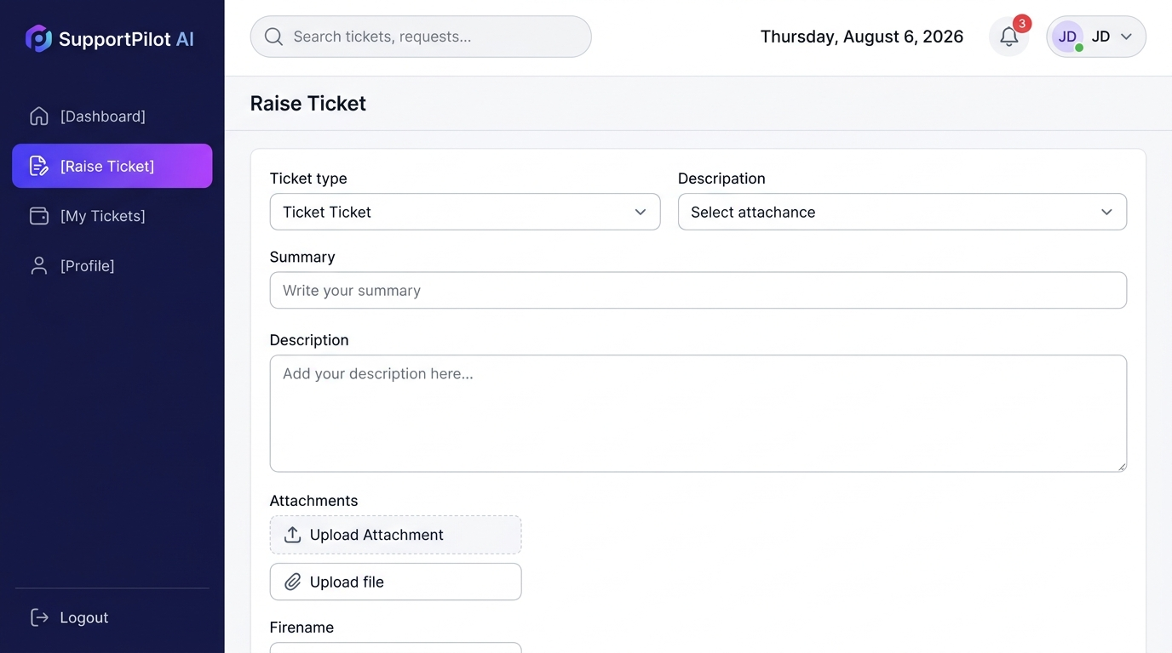
SYSTEM CAPABILITIES & ROADMAP
IMPLEMENTATION & FUTURE SCOPE
IMPLEMENTED SYSTEM CAPABILITIES
• Implemented: User Portal • Admin Operations Portal • AI Assistance • Guided Troubleshooting
• Capabilities: Ticket Management • Engineer Assignment • Ticket Tracking • Dashboard KPIs
FUTURE TECHNICAL ROADMAP
01 — EMAIL NOTIFICATIONS
Ticket assignment and resolution notifications.
02 — ENTERPRISE SSO
OAuth2 / SAML-based enterprise authentication.
03 — VOICE-TO-TEXT REPORTING
Voice-based issue description.
SupportPilot AI — Technical Project Presentation | Slide 8 of 9

Slide 9
THANK YOU
Questions & Technical Discussion
SUPPORTPILOT AI AI-Assisted Diagnosis • Intelligent Ticket Management
SupportPilot AI — Technical Project Presentation | Slide 9 of 9

